Slide 1
Farmacocinetica ed interazioni farmacologiche dei nuovi anticoagulanti orali
Prof. Alberto Corsini
Università degli Studi di Milano

Slide 2
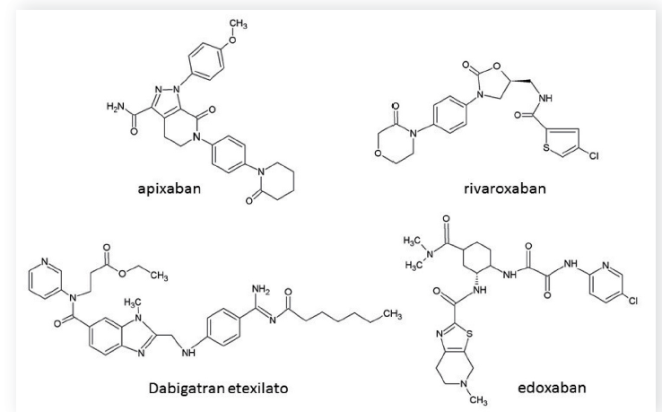
Struttura chimica dei nuovi anticoagulanti orali
Ferri N and Corsini A G Ital Cardiol 2015;16(9 Suppl 1):3S-16S

Slide 3
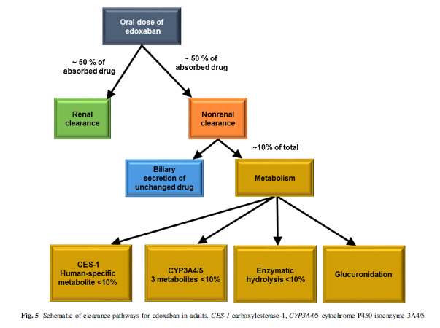
Parasrampuria DA and Kenneth E. Truitt KE Clin Pharmacokinet (2016) 55:641–655

Slide 4
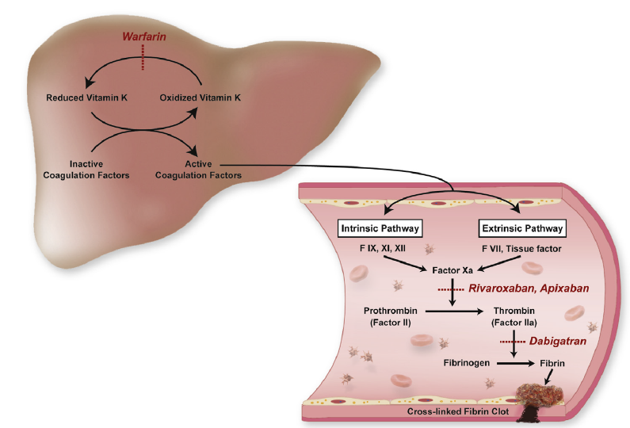
Siti d’azione del warfarin e dei nuovi anticoagulanti orali nella cascata coagulativa
Ferri N and Corsini A G Ital Cardiol 2015;16(9 Suppl 1):3S-16S

Slide 5
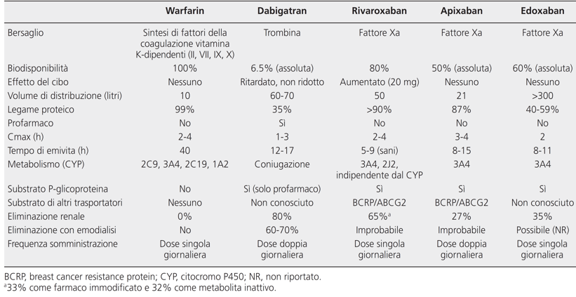
Principali caratteristiche farmacocinetiche di warfarin e dei nuovi anticoagulanti orali

Slide 6
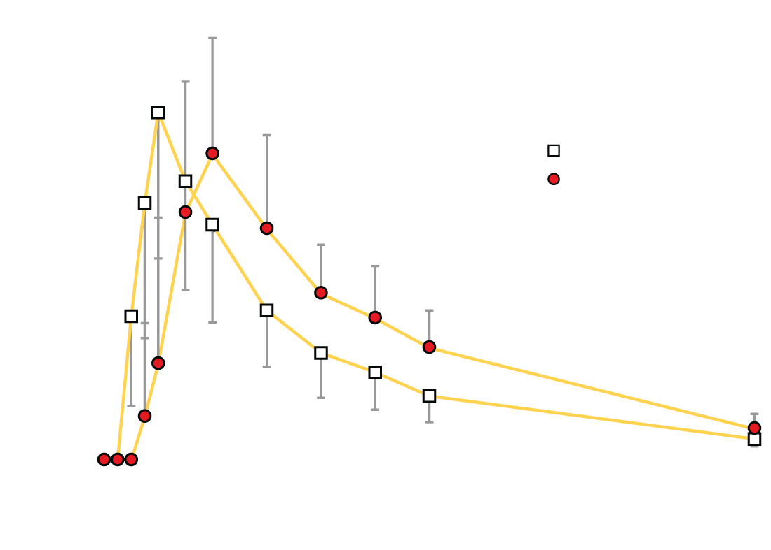
Rapid Absorption
A single 150 mg dose in 12 healthy males.
Rapid absorption (C_{max} in up to 2 hours)
  Food delayed C_{max} by 2 hours
  Surgery delayed C_{max} by 4 hours
Stangier J.: Clin Pharmacokinet 2008:47:285-295
Notes:
Reference
Stangier J. Clinical Pharmacokinetics and Pharmacodynamics of the Oral Direct Thrombin Inhibitor Dabigatran Etexilate. Clin Pharmacokinet 2008; 47:285-295

Slide 7
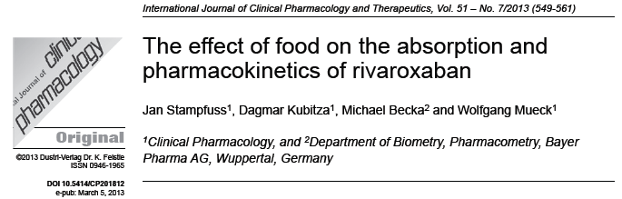
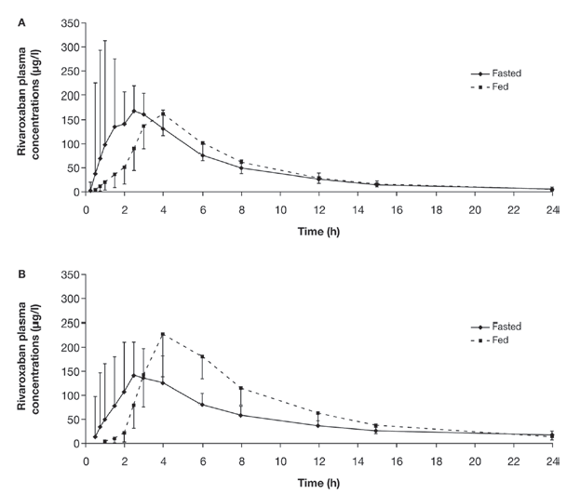

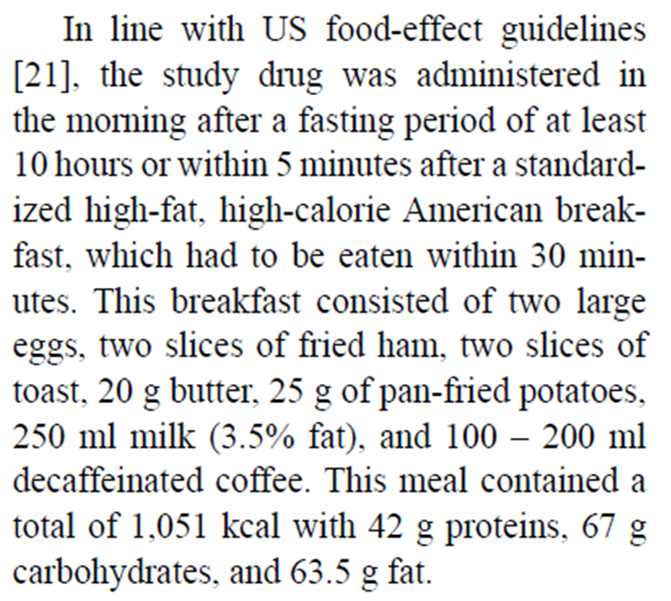

Slide 8
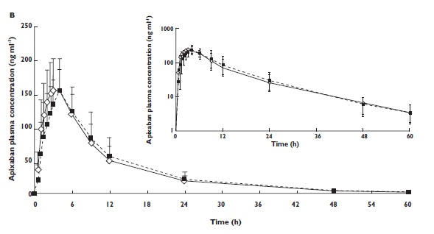
Foods does not affect the pharmacokinetic profile of apixaban
, ◊ Fasted (n = 23); ■ Fed (n = 22
Frost C et al Br J Clin Pharmacol. 2013 Nov;76(5):776-86

Slide 9
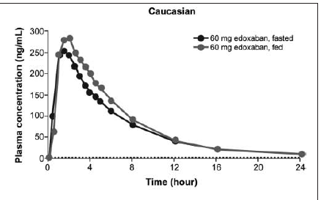
Plasma concentrations of edoxaban following single oral doses of 60 mg in volunteers in fed and fasted states
Mendell J et al. Journal of Clinical Pharmacology, 2011;51:687-694

Slide 10
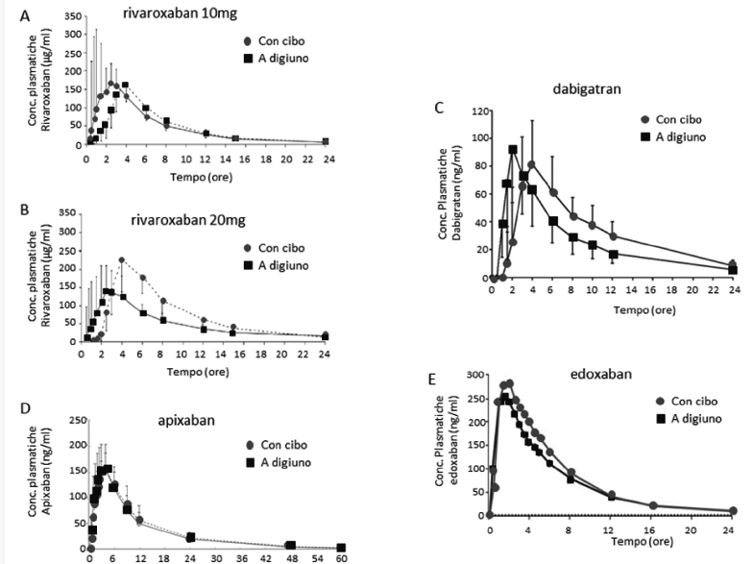
Profilo farmacocinetico dei nuovi anticoagulanti orali in presenza ed assenza di cibo
Ferri N and Corsini A G Ital Cardiol 2015;16(9 Suppl 1):3S-16S

Slide 11
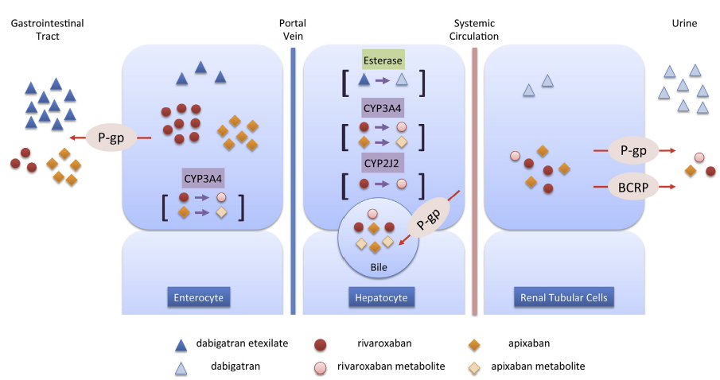
Summary of absorption, metabolism, and excretion of dabigatran, rivaroxaban, and apixaban
Gong IY and Kim RB Canadian Journal of Cardiology 29 (2013) S24eS33

Slide 12
Le Proteine di Trasporto
Sono delle proteine multifunzionali
Hanno un ruolo fisiologico nella modulazione del trasporto di diverse sostanze quali zuccheri, lipidi, aminoacidi, acidi biliari, steroidi e ormoni.

Slide 13
Le Proteine di Trasporto
Captazione: facilitano l’entrata di sostanze (farmaci) all’interno delle cellule.
OATP (organic anion transporting polypeptide)
OAT (organic anion transporter)
PEPT (peptide transporter)
Efflusso: esportano sostanze (farmaci) all’esterno delle cellule, anche contro un gradiente di concentrazione.
ABC (ATP binding cassette):
  ABCB (P-glicoproteina)
  MDR1 (multidrug resistance protein 1)
BCRP (breast cancer resistance protein)

Slide 14
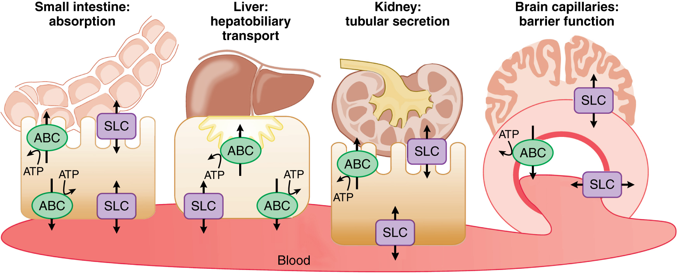
Roles of membrane transporters (T) in pharmacokinetic pathways. T are setting systemic drug levels
Goodman and Gilman’s. The Pharmacological Basis of Therapeutics, 12/E, 2011

Slide 15
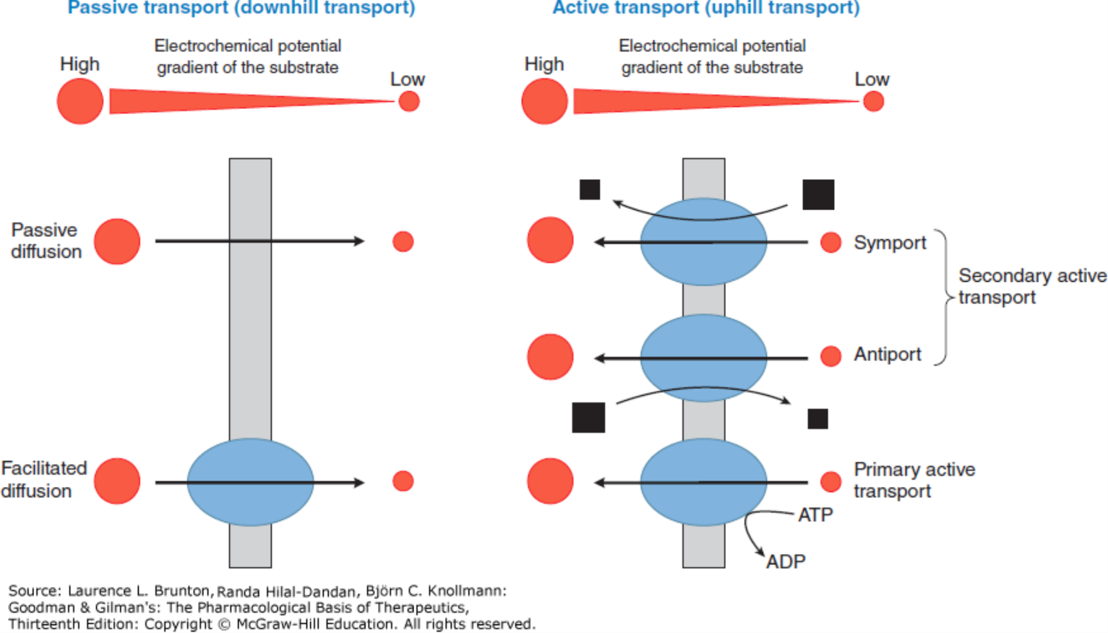

Classification of membrane transport mechanisms. Red circles depict the substrate. Size of the circles is proportional to the concentration of the substrate. Arrows show the direction of flux. Black squares represent the ion that supplies the driving force for transport (size is proportional to the concentration of the ion). Blue ovals depict transport proteins.
Source: Membrane Transporters and Drug Response, Goodman & Gilman's: The Pharmacological Basis of Therapeutics, 13e
Citation: Brunton LL, Hilal-Dandan R, Knollmann BC. Goodman & Gilman's: The Pharmacological Basis of Therapeutics, 13e; 2017 Available at: http://accessmedicine.mhmedical.com/content.aspx?bookid=2189&sectionid=166183302 Accessed: February 03, 2018
Copyright © 2018 McGraw-Hill Education. All rights reserved

Slide 16
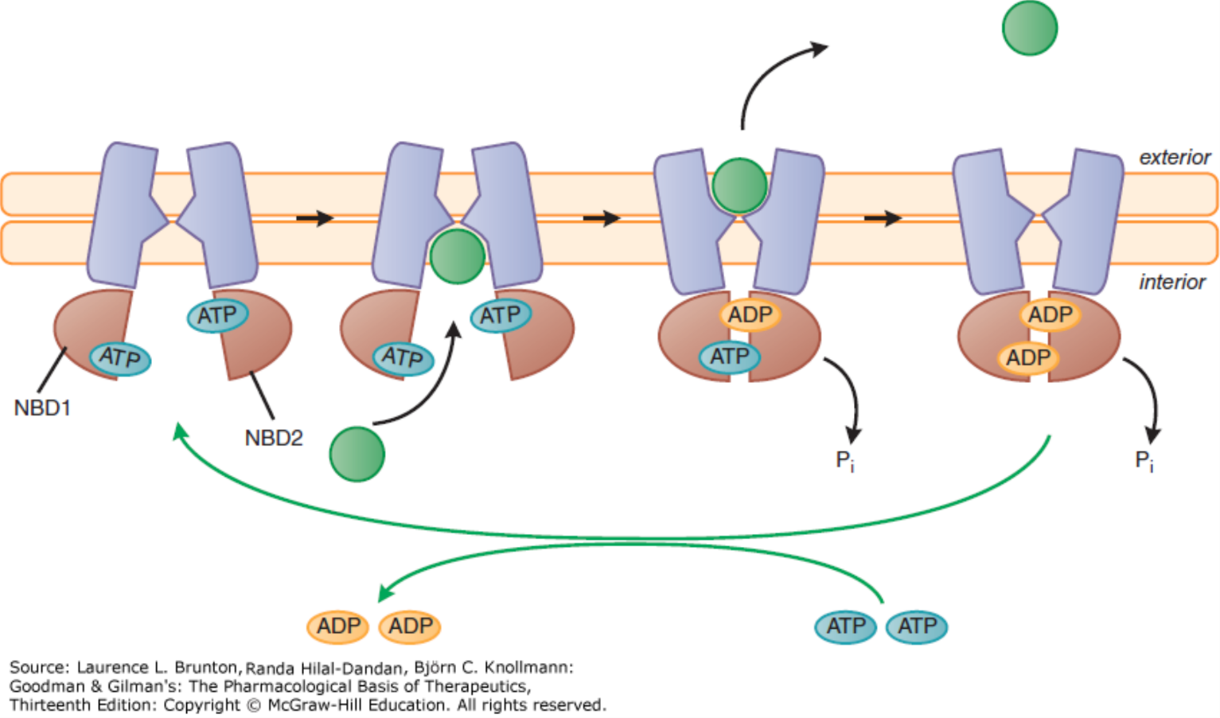
Model of ABC transporter function. The transporter accepts a solute molecule at the cytoplasmic membrane surface when its nucleotide NBDs are fully charged with ATP. Sequential hydrolysis of the ATP molecules produces steric change and leads to the translocation and release of the solute at the exterior membrane surface. Exchange of ADP for ATP on both NBDs completes the cycle and restores the system for readiness to transport another solute molecule.
Source: Membrane Transporters and Drug Response, Goodman & Gilman's: The Pharmacological Basis of Therapeutics, 13e
Citation: Brunton LL, Hilal-Dandan R, Knollmann BC. Goodman & Gilman's: The Pharmacological Basis of Therapeutics, 13e; 2017 Available at: http://accessmedicine.mhmedical.com/content.aspx?bookid=2189&sectionid=166183302 Accessed: February 03, 2018
Copyright © 2018 McGraw-Hill Education. All rights reserved

Slide 17
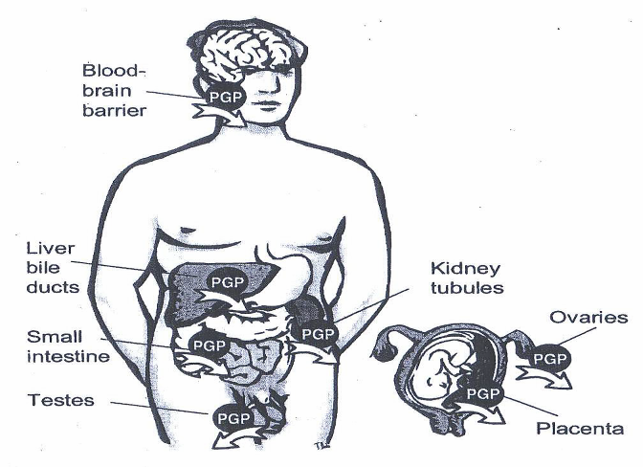
P-gp TISSUE DISTRIBUTION
C. Marzolini et al., Clin. Pharmacol. Ther., 75: 13-33, 2004

Slide 18
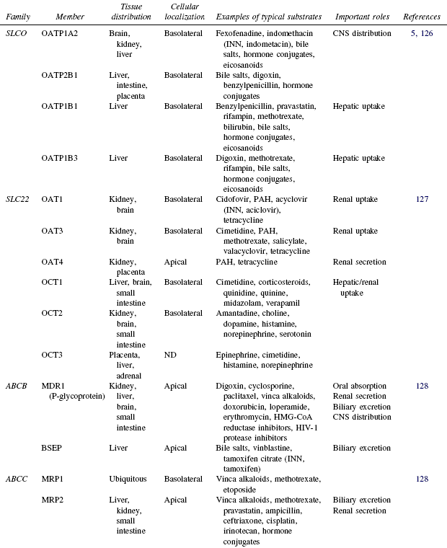
HUMAN DRUG TRANSPORTERS
Ho R.H. et al., Clin. Pharmacol. Ther. 78: 260-77, 2005

Slide 19
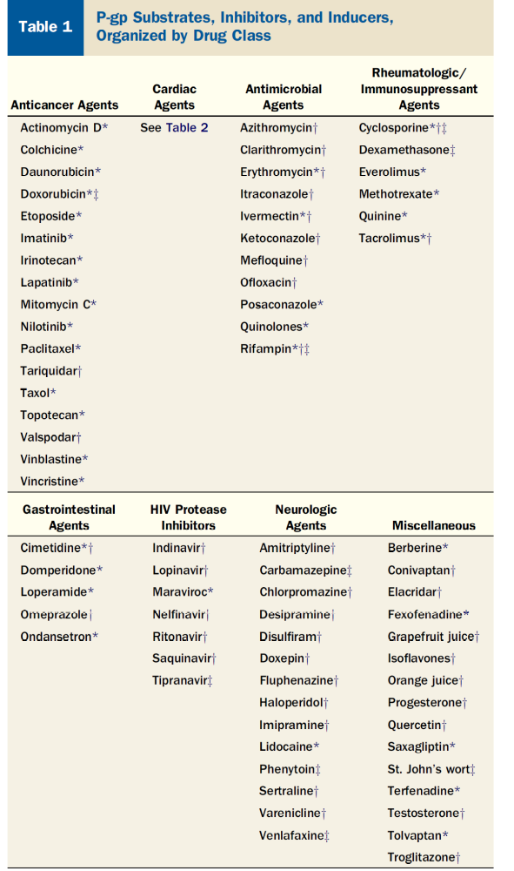
Wessler JD et al. J Am Coll Cardiol 2013;61:2495–502

Slide 20
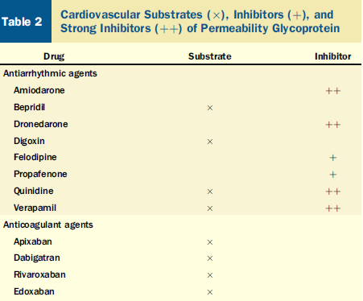
Wessler JD et al. J Am Coll Cardiol 2013;61:2495–502

Slide 21
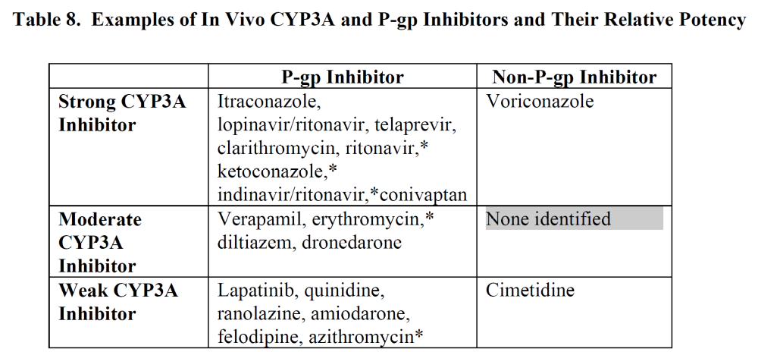
FDA 2012

Slide 22
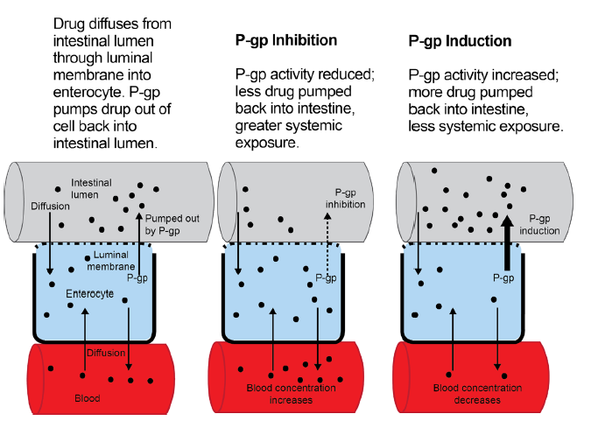
P-gp effect on drug exposure
Burnett AE et al J Thromb Thrombolysis (2016) 41:206–232

Slide 23
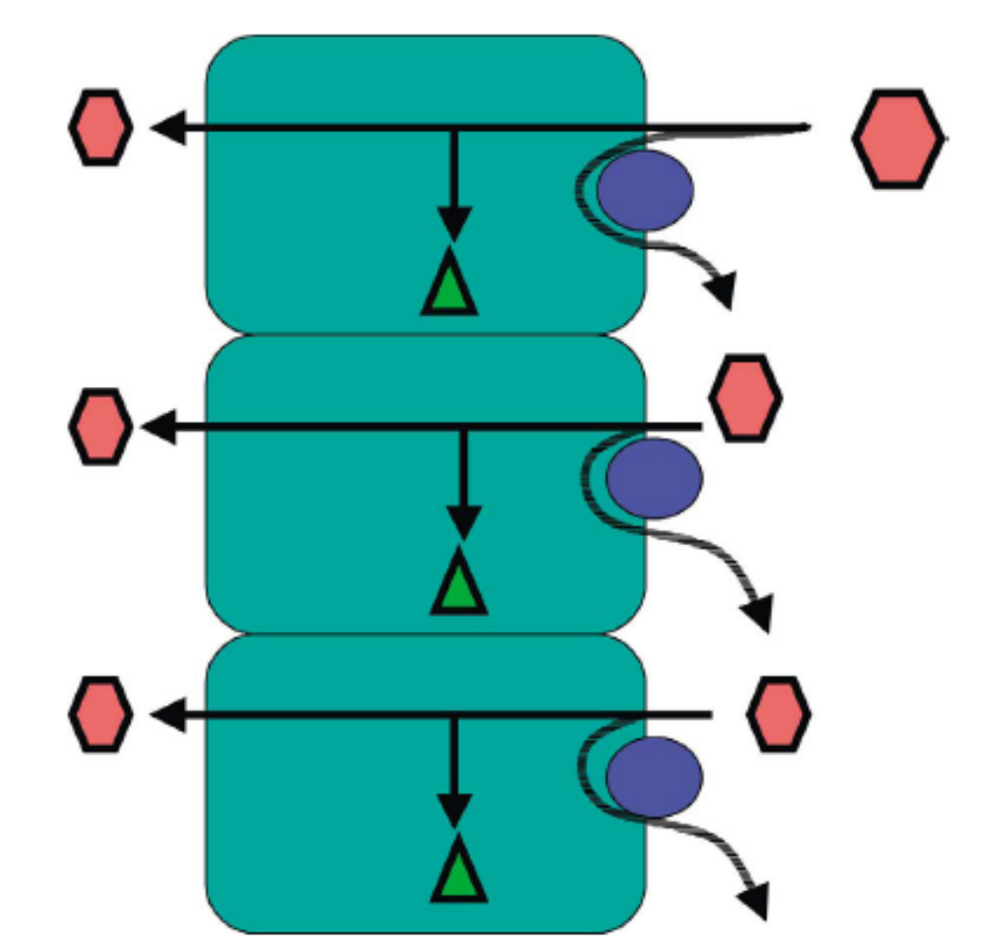
What is P-gp and how does it work?
Intestinal apical cell
Drug
P-gp
Metab
Gastro-
intestinal
lumen
“GUT”
Blood
circulation
Adapted from: J Lin Adv Drug Deliv Rev 2003; 55:53

Slide 24
Dabigatran etexilate and P-gp
When high concentrations of a strong P-gp inhibitor are present in the gut at the time Dabigatran is ingested, this can lead to increased systemic delivery of Dabigatran
Intestinal apical cell
Dabigatran etexilate
P-gp
Dabigatran plasma level
Metab
Gastro-
intestinal
lumen
“GUT”
Blood
circulation
Adapted from: J Lin Adv Drug Deliv Rev 2003; 55:53

Slide 25
Dabigatran etexilate and P-gp
Standard of such DDI studies is to build a study design to show the maximal possible effect
Therefore the results of such DDI studies need to be interpreted with caution
    Digoxin (P-GP substrate)
    Amiodarone (moderate to strong P-gp inhibitor)
    Verapamil (strong P-gp inhibitor)
    Quinidine (strong P-gp inhibitor)
    Clarithromycin (strong P-gp inhibitor)

Slide 26
P-GP Inhibitors
Amiodarone: Dabigatran exposure in healthy subjects was increased by 60 % in the presence of amiodarone
Verapamil: When dabigatran 150 mg was coadministered with oral verapamil, the C_{max} and AUC of dabigatran were increased,but the magnitude of this change differs, depending on timing of administration and formulation of verapamil
Clarithromycin: Dabigatan exposure (AUC) in healthy subjects was increased by about 19 % in the presence of clarithromycin without any clinical safety concern
Current US labeling for dabigatran with rifampicin a P-GP inducers should be avoided
Pradaxa® – Summary of Product Characteristics

Slide 27
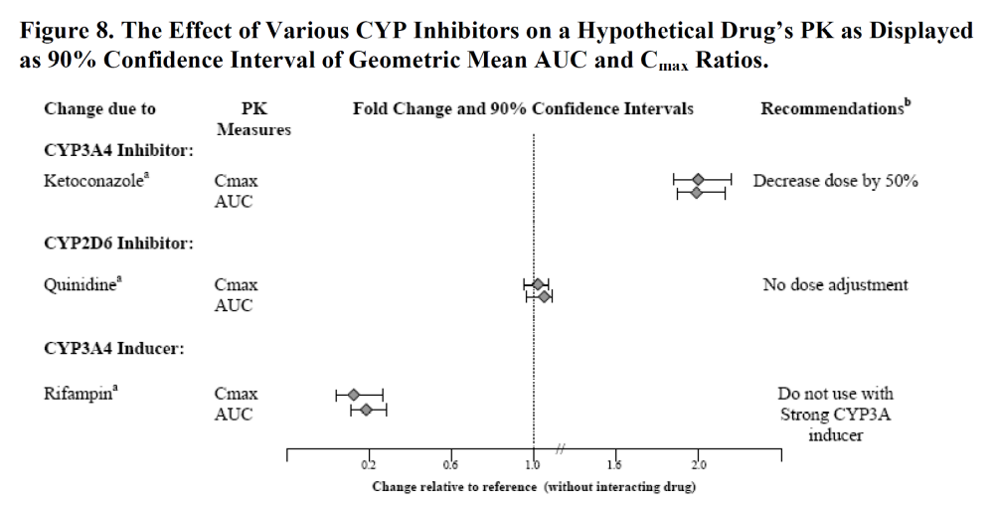
FDA 2012

Slide 28
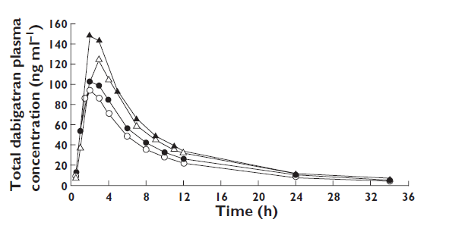
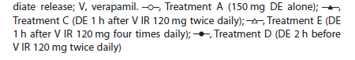
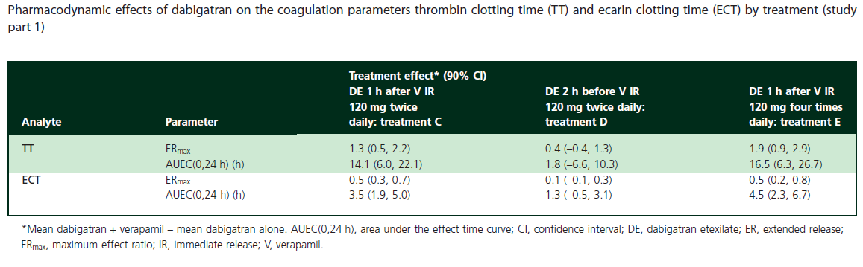
Plasma concentration–time profiles of dabigatran after 150 mg dabigatran alone or with co-administration of 120 mg verapamil
S. Härtter et al.
Br J Clin Pharmacol 75:1053–1062-2012

Slide 29
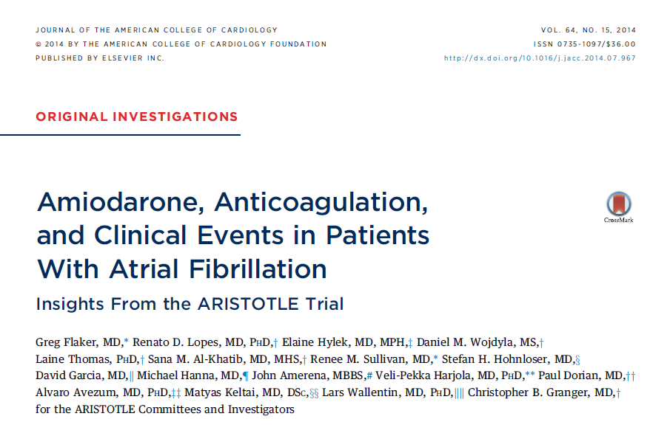

Slide 30
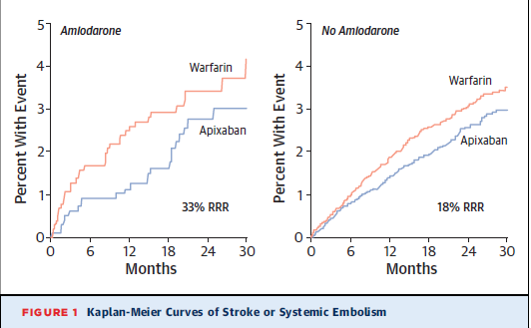
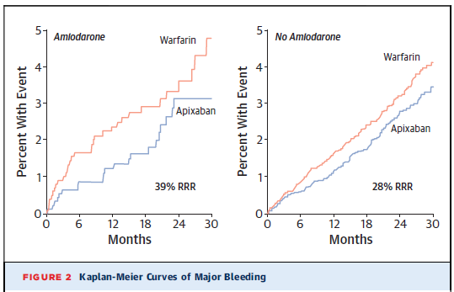
JA C C VO L . 6 4, 2 0 1 4 Flaker et al.
O C T O B E R 1 4 , 2 0 1 4 : 1 5 4 1 – 5 0

Slide 31
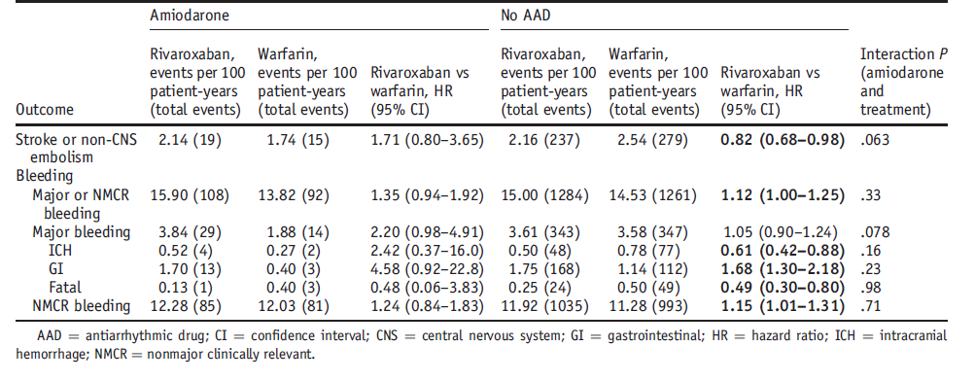
Adjusted outcomes of rivaroxaban vs warfarin stratified by amiodarone use at baseline
Steinberg BA et al. Heart Rhythm 2014;11:925–932)

Slide 32
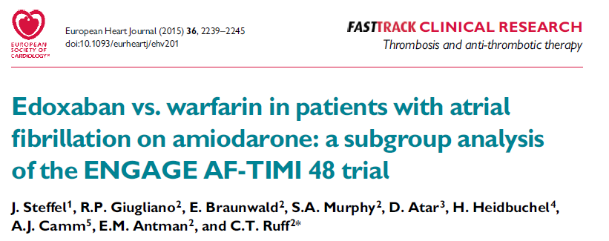
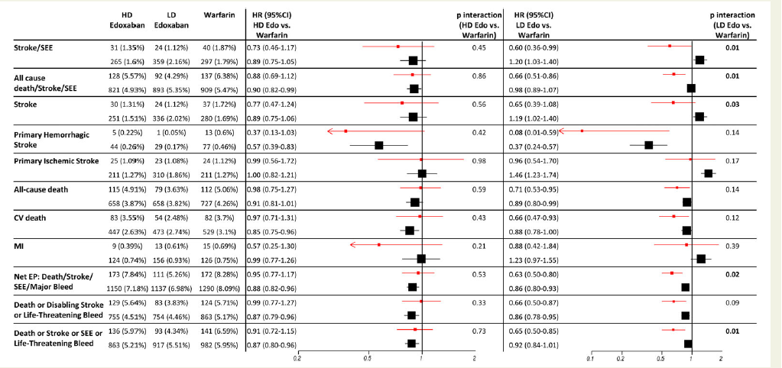
Efficacy of edoxaban vs. warfarin in patients with and without amiodarone at baseline

Slide 33
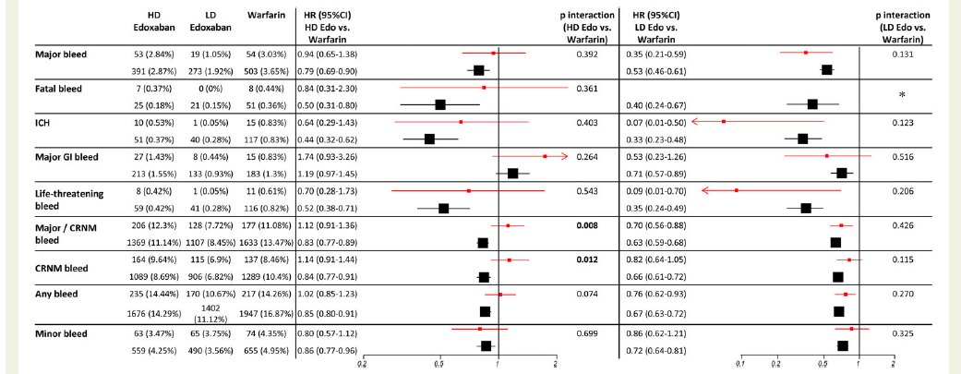
Safety of edoxaban vs. warfarin in patients with and without amiodarone at baseline
European Heart Journal (2015) 36, 2239–2245

Slide 34
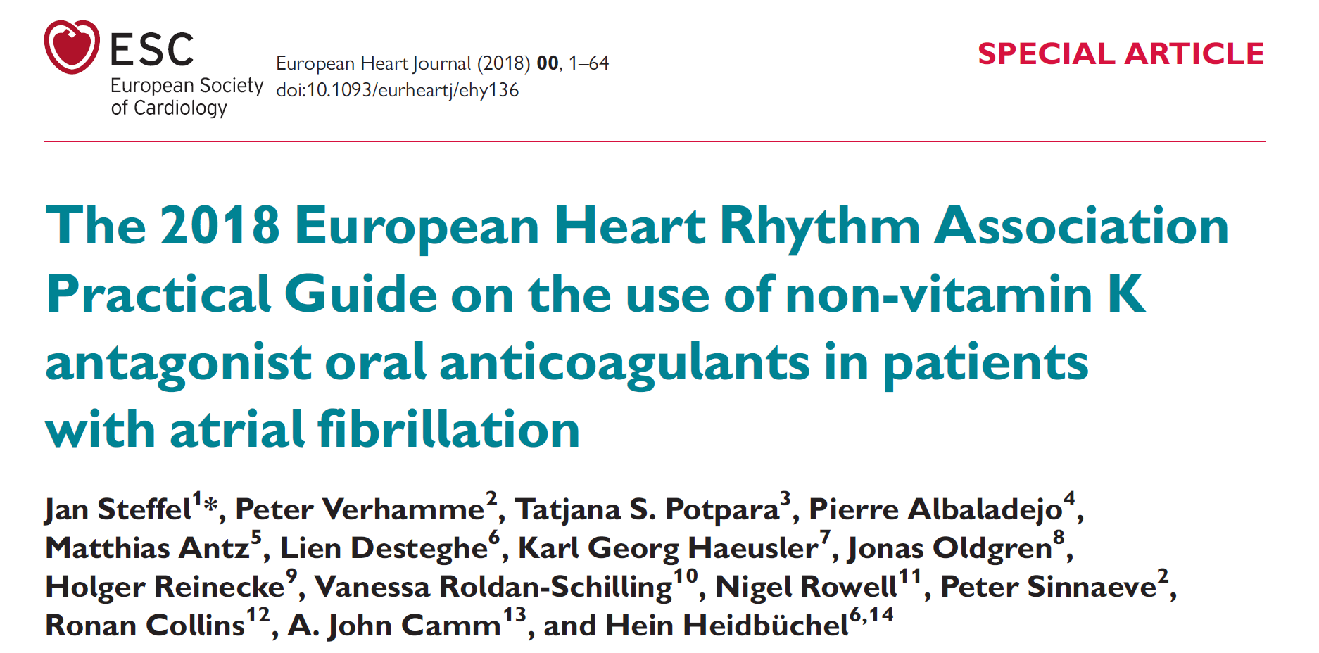

Slide 35
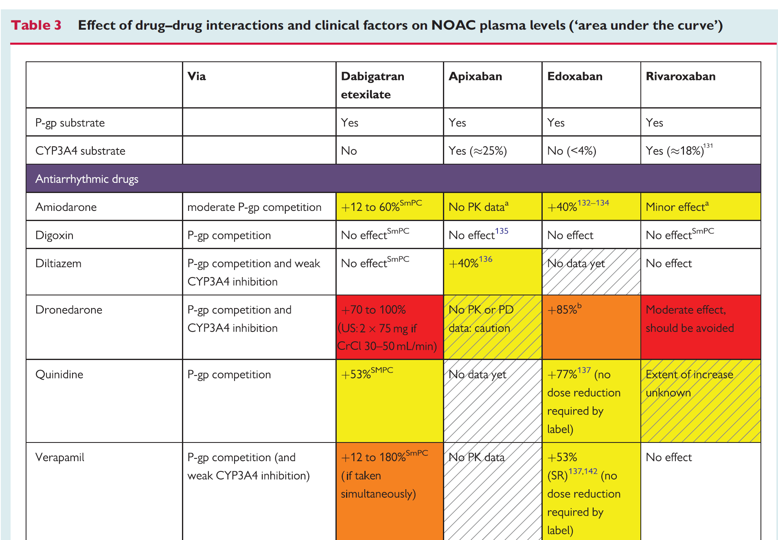
Steffel J et al European Heart Journal (2018) 00, 1–64

Slide 36
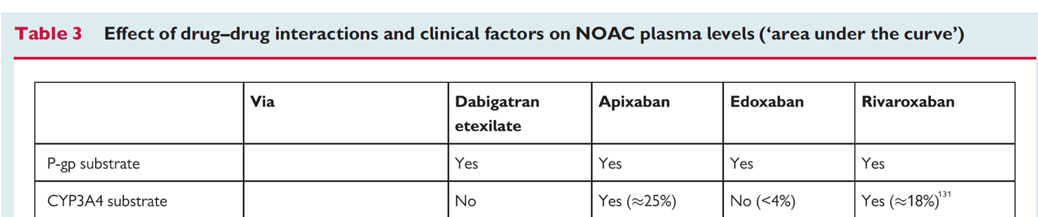
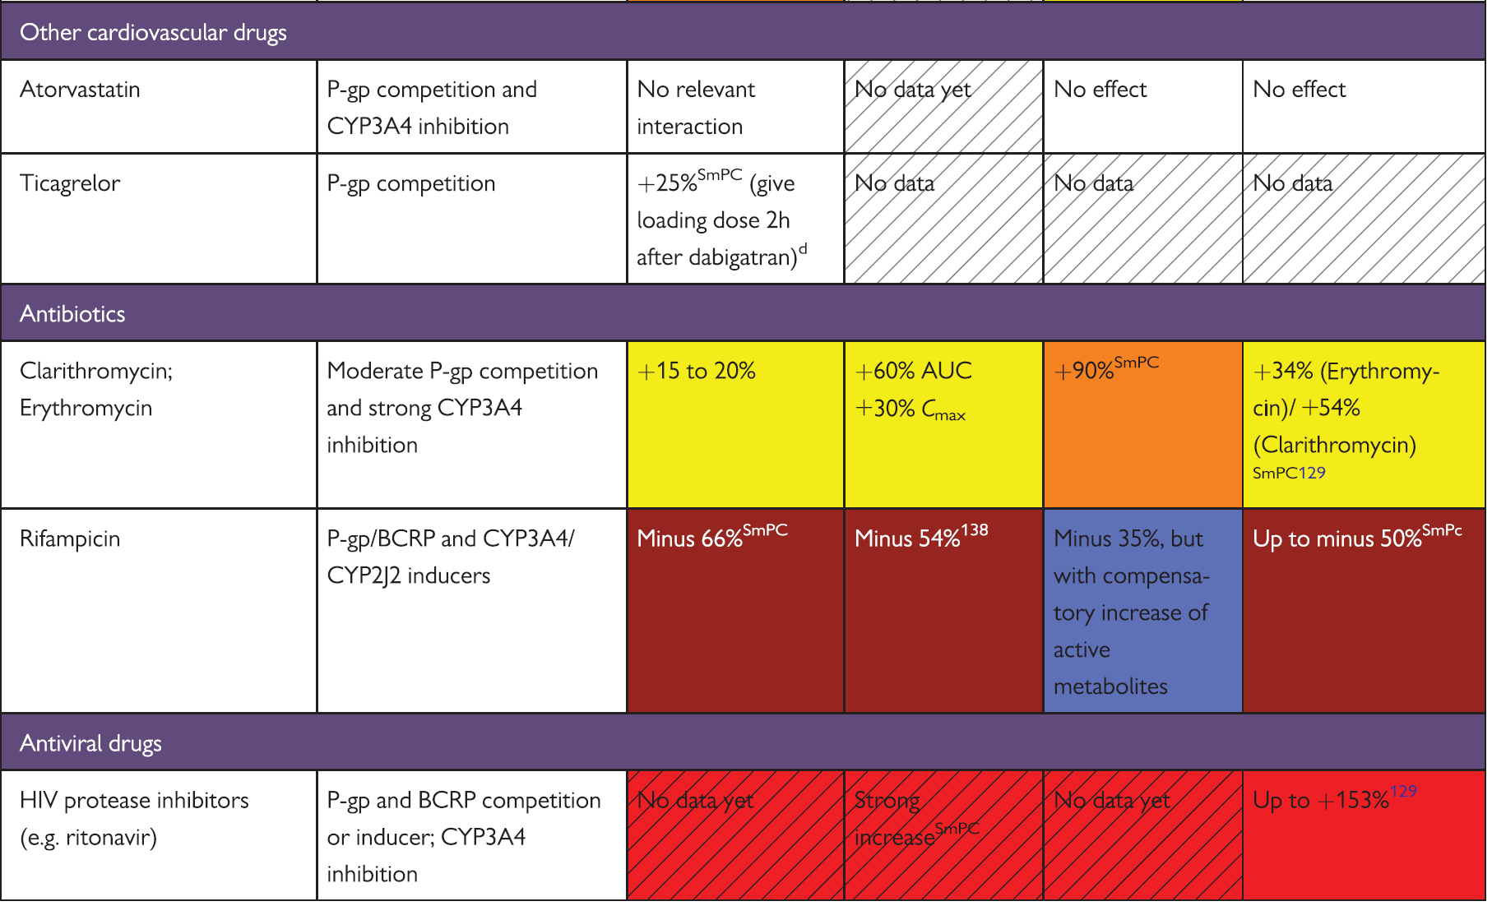

Slide 37
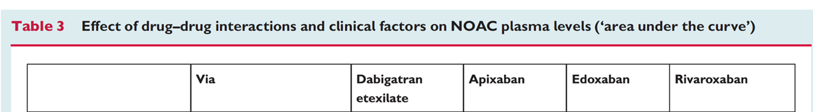
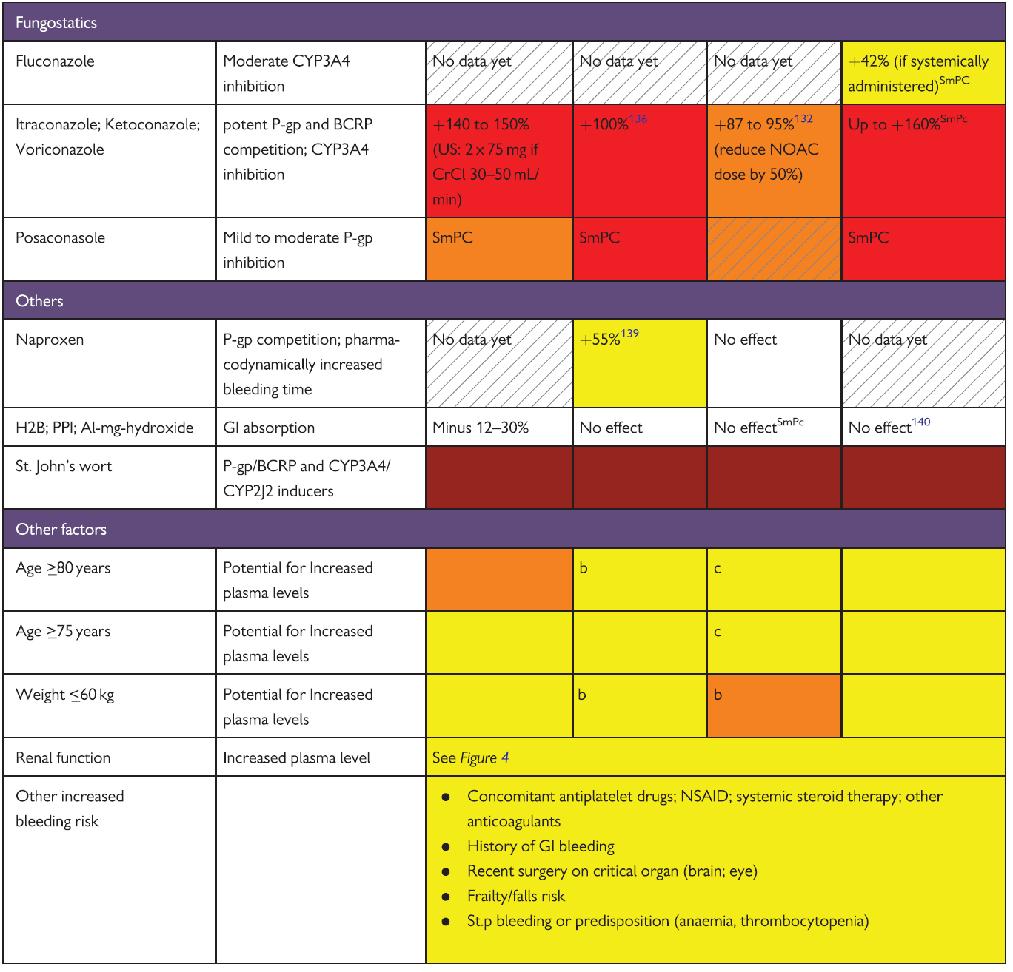
Steffel J et al European Heart Journal (2018) 00, 1–64
Steffel J et al European Heart Journal (2018) 00, 1–64

Slide 38
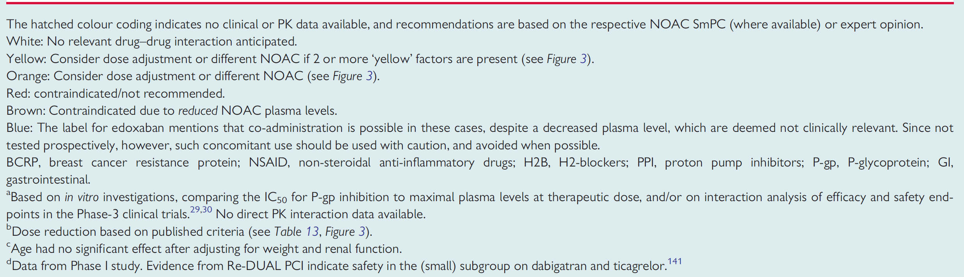

Slide 39
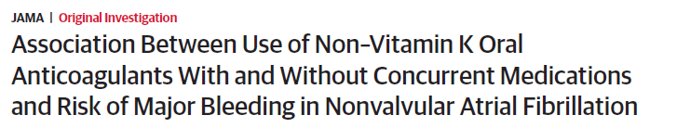
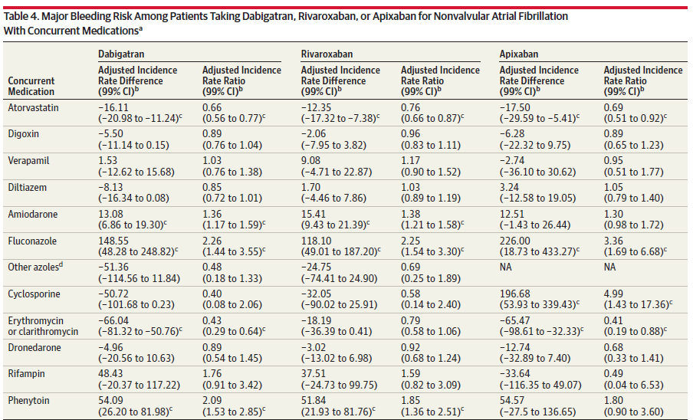
Chang S et al JAMA. 2017;318(13):1250-1259

Slide 40
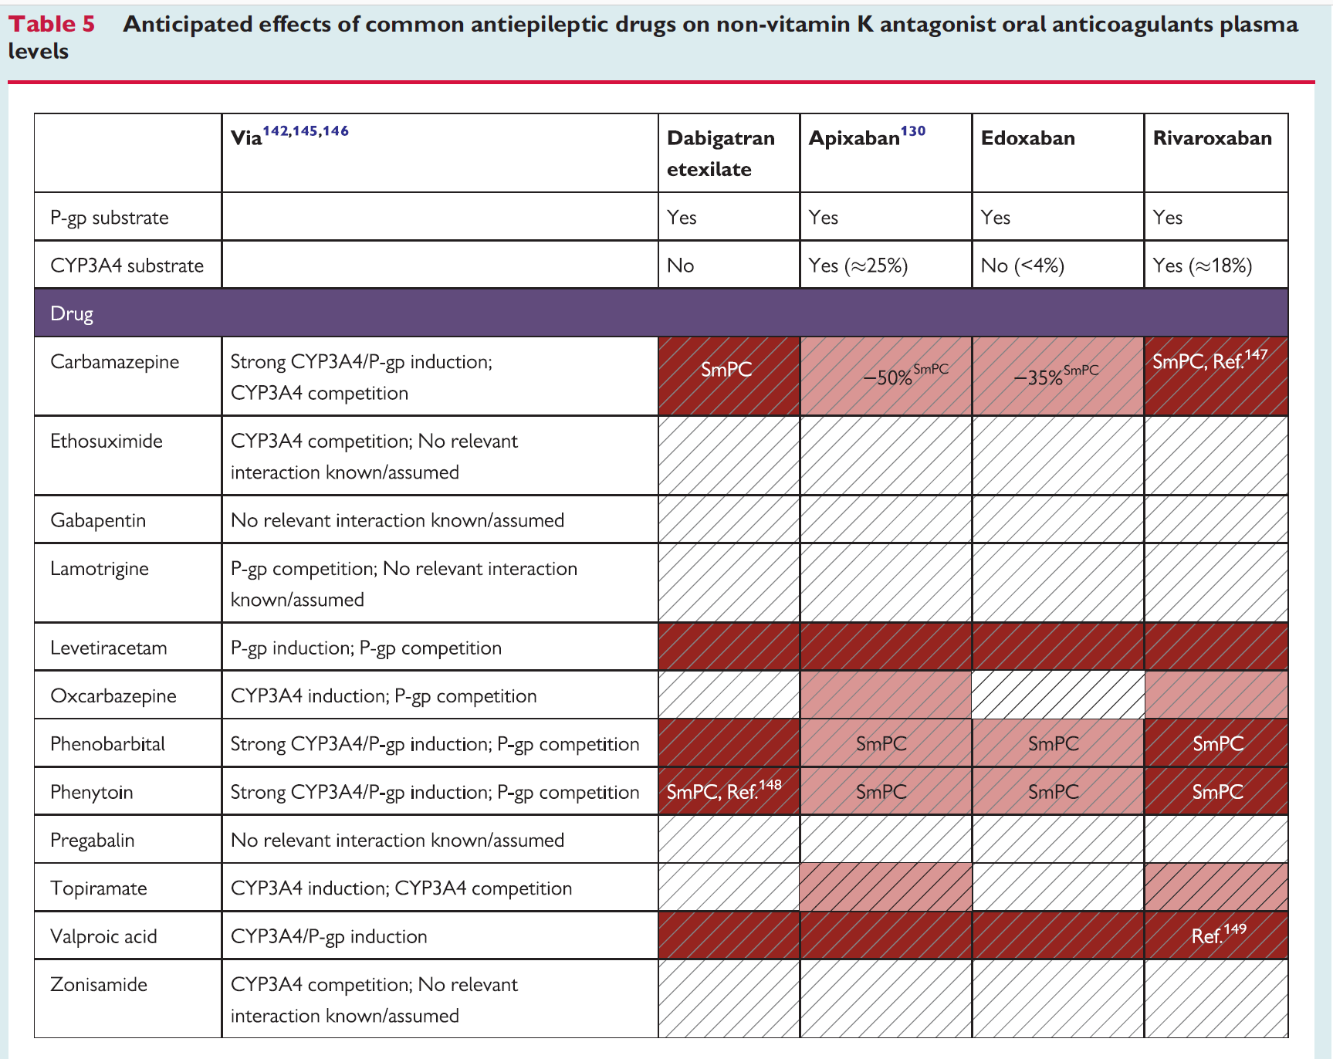

Slide 41
